Slide 1
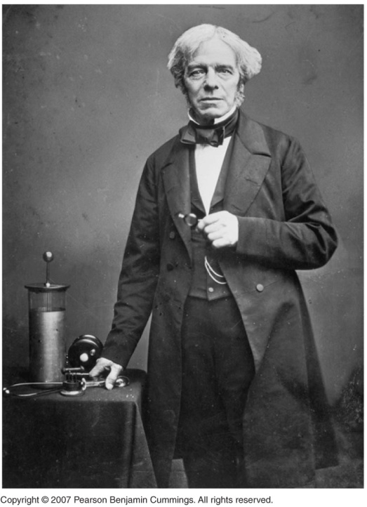
Stoichiometry of Cells
Faraday’s Law

Slide 2
The mass deposited or eroded from an electrode depends on the quantity of electricity.
Quantity of electricity – coulomb (Q)
Q is the product of current in amps times time in seconds
Q = It
coulomb
time in seconds
current in amperes (amp)

Slide 3
.
Example: Calculate the charge that passes through one 300kA cell in a 24 hour period.

Slide 4
Calculate the charge that passes through one 300kA cell in a 24 hour period.
Q = It
= (300kA x 1000A/kA)(24 h x 3600s/h)
= (300000C/s )(86400s) = 2.6 x 10¹⁰C

Slide 5
Counting Electrons: Coulometry and Faraday’s Law of Electrolysis
A coulomb is the amount of charge that passes a given point when a current of one ampere (A) flows for one second. Charge (C) = current (A) * time (s)
1 amp = 1 coulomb/second

Slide 6
Faraday’s Law states that during electrolysis, one faraday of electricity (96,487 coulombs) reduces and oxidizes, respectively, one equivalent of the oxidizing agent and the reducing agent.
This corresponds to the passage of one mole of electrons through the electrolytic cell.

Slide 7
Counting Electrons: Coulometry and Faraday’s Law of Electrolysis
The amount of material consumed or produced in a reaction can be calculated from the stoichiometry of an electrolysis reaction, the amount of current passed, and the duration of the electrolytic reaction.

Slide 8
Calculate the mass of palladium produced by the reduction of palladium (II) ions during the passage of 3.20 amperes of current through a solution of palladium (II) sulfate for 30.0 minutes.

Slide 9
Calculate the mass of palladium produced by the reduction of palladium (II) ions during the passage of 3.20 amperes of current through a solution of palladium (II) sulfate for 30.0 minutes.

