Slide 1
Standard Enthalpies of Formation 5.5

Slide 2
Standard Enthalpies of Formation
The term standard state refers to the standard thermodynamic conditions chosen for substances when listing or comparing thermodynamic data: 1 atmosphere pressure and the specified temperature (usually 25 ºC).
The enthalpy change for a reaction in which reactants are in their standard states is denoted ΔHº (“delta H zero” or “delta H naught”).
Notes:
4

Slide 3
Standard Enthalpies of Formation
The standard enthalpy of formation of a substance, denoted ΔH_{f}º, is the enthalpy change for the formation of one mole of a substance in its standard state from its component elements in their standard state.
Note that the standard enthalpy of formation for a pure element in its standard state is zero.
Notes:
4

Slide 4
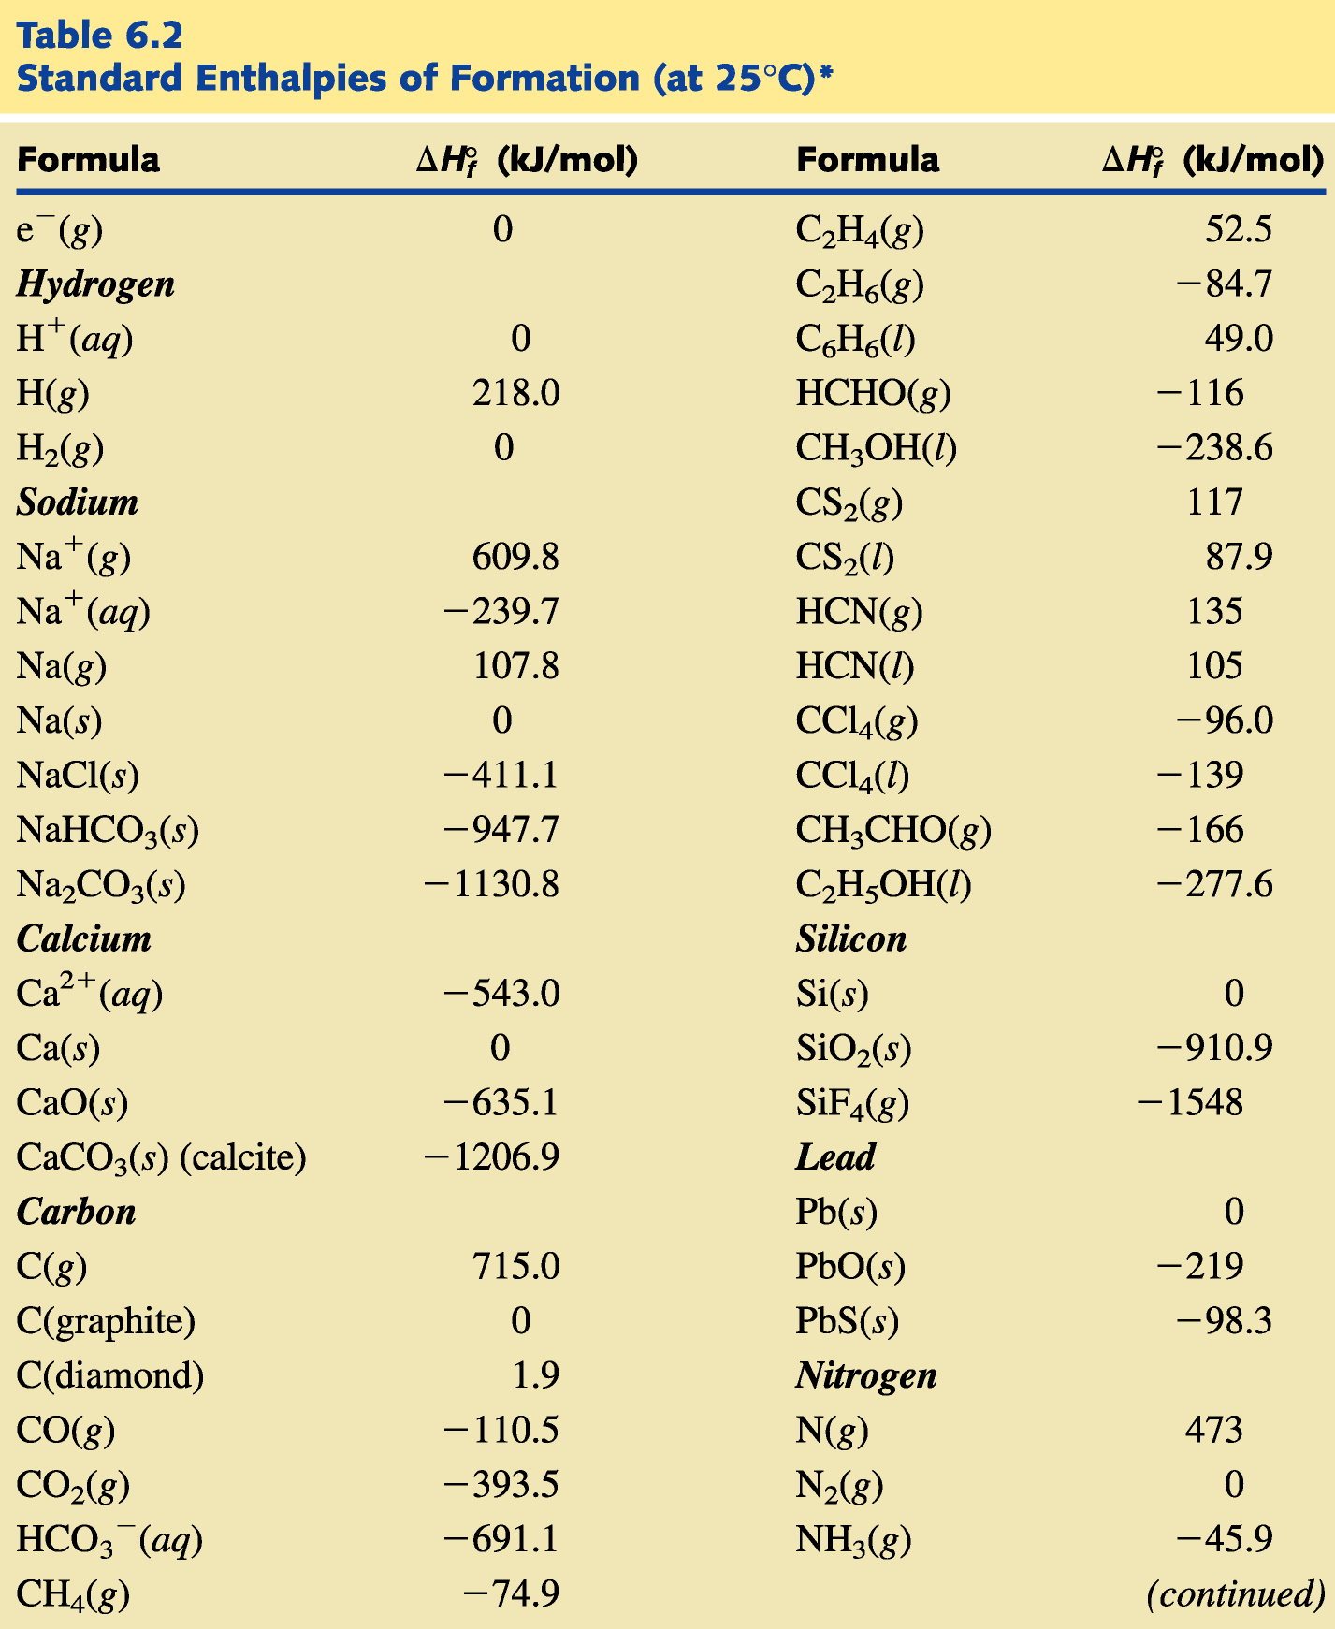

Slide 5
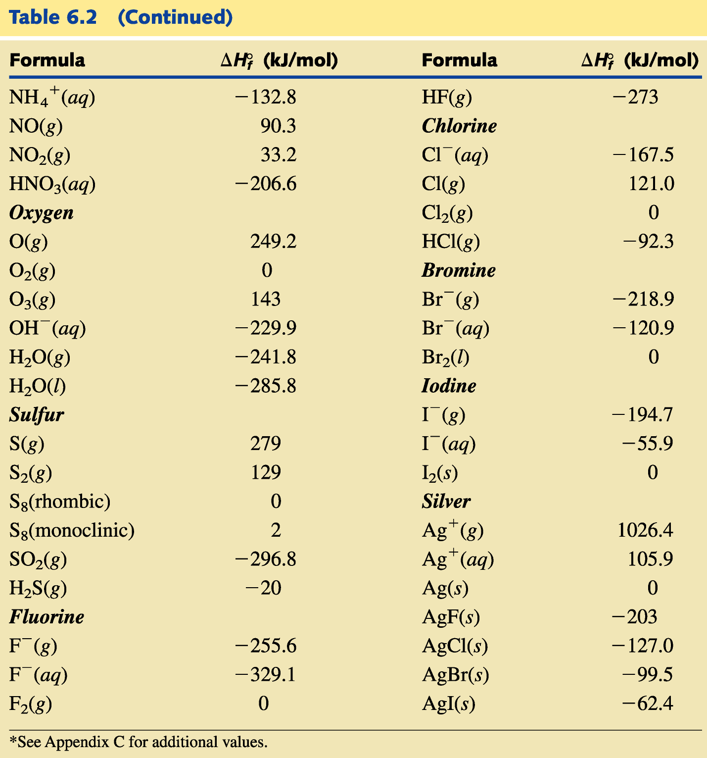

Slide 6
Standard Enthalpies of Formation
The law of summation of heats of formation states that the enthalpy of a reaction is equal to the total formation energy of the products minus that of the reactants.
Σ is the mathematical symbol meaning “the sum of”, and m and n are the coefficients of the substances in the chemical equation.
Notes:
4

Slide 7
A Problem to Consider
Large quantities of ammonia are used to prepare nitric acid according to the following equation:
What is the standard enthalpy change for this reaction? Use Table 6.2 for data.
Notes:
4

Slide 8
A Problem to Consider
You record the values of ΔH_{f}º under the formulas in the equation, multiplying them by the coefficients in the equation.
You can calculate ΔHº by subtracting the values for the reactants from the values for the products.
Notes:
4

