Slide 1
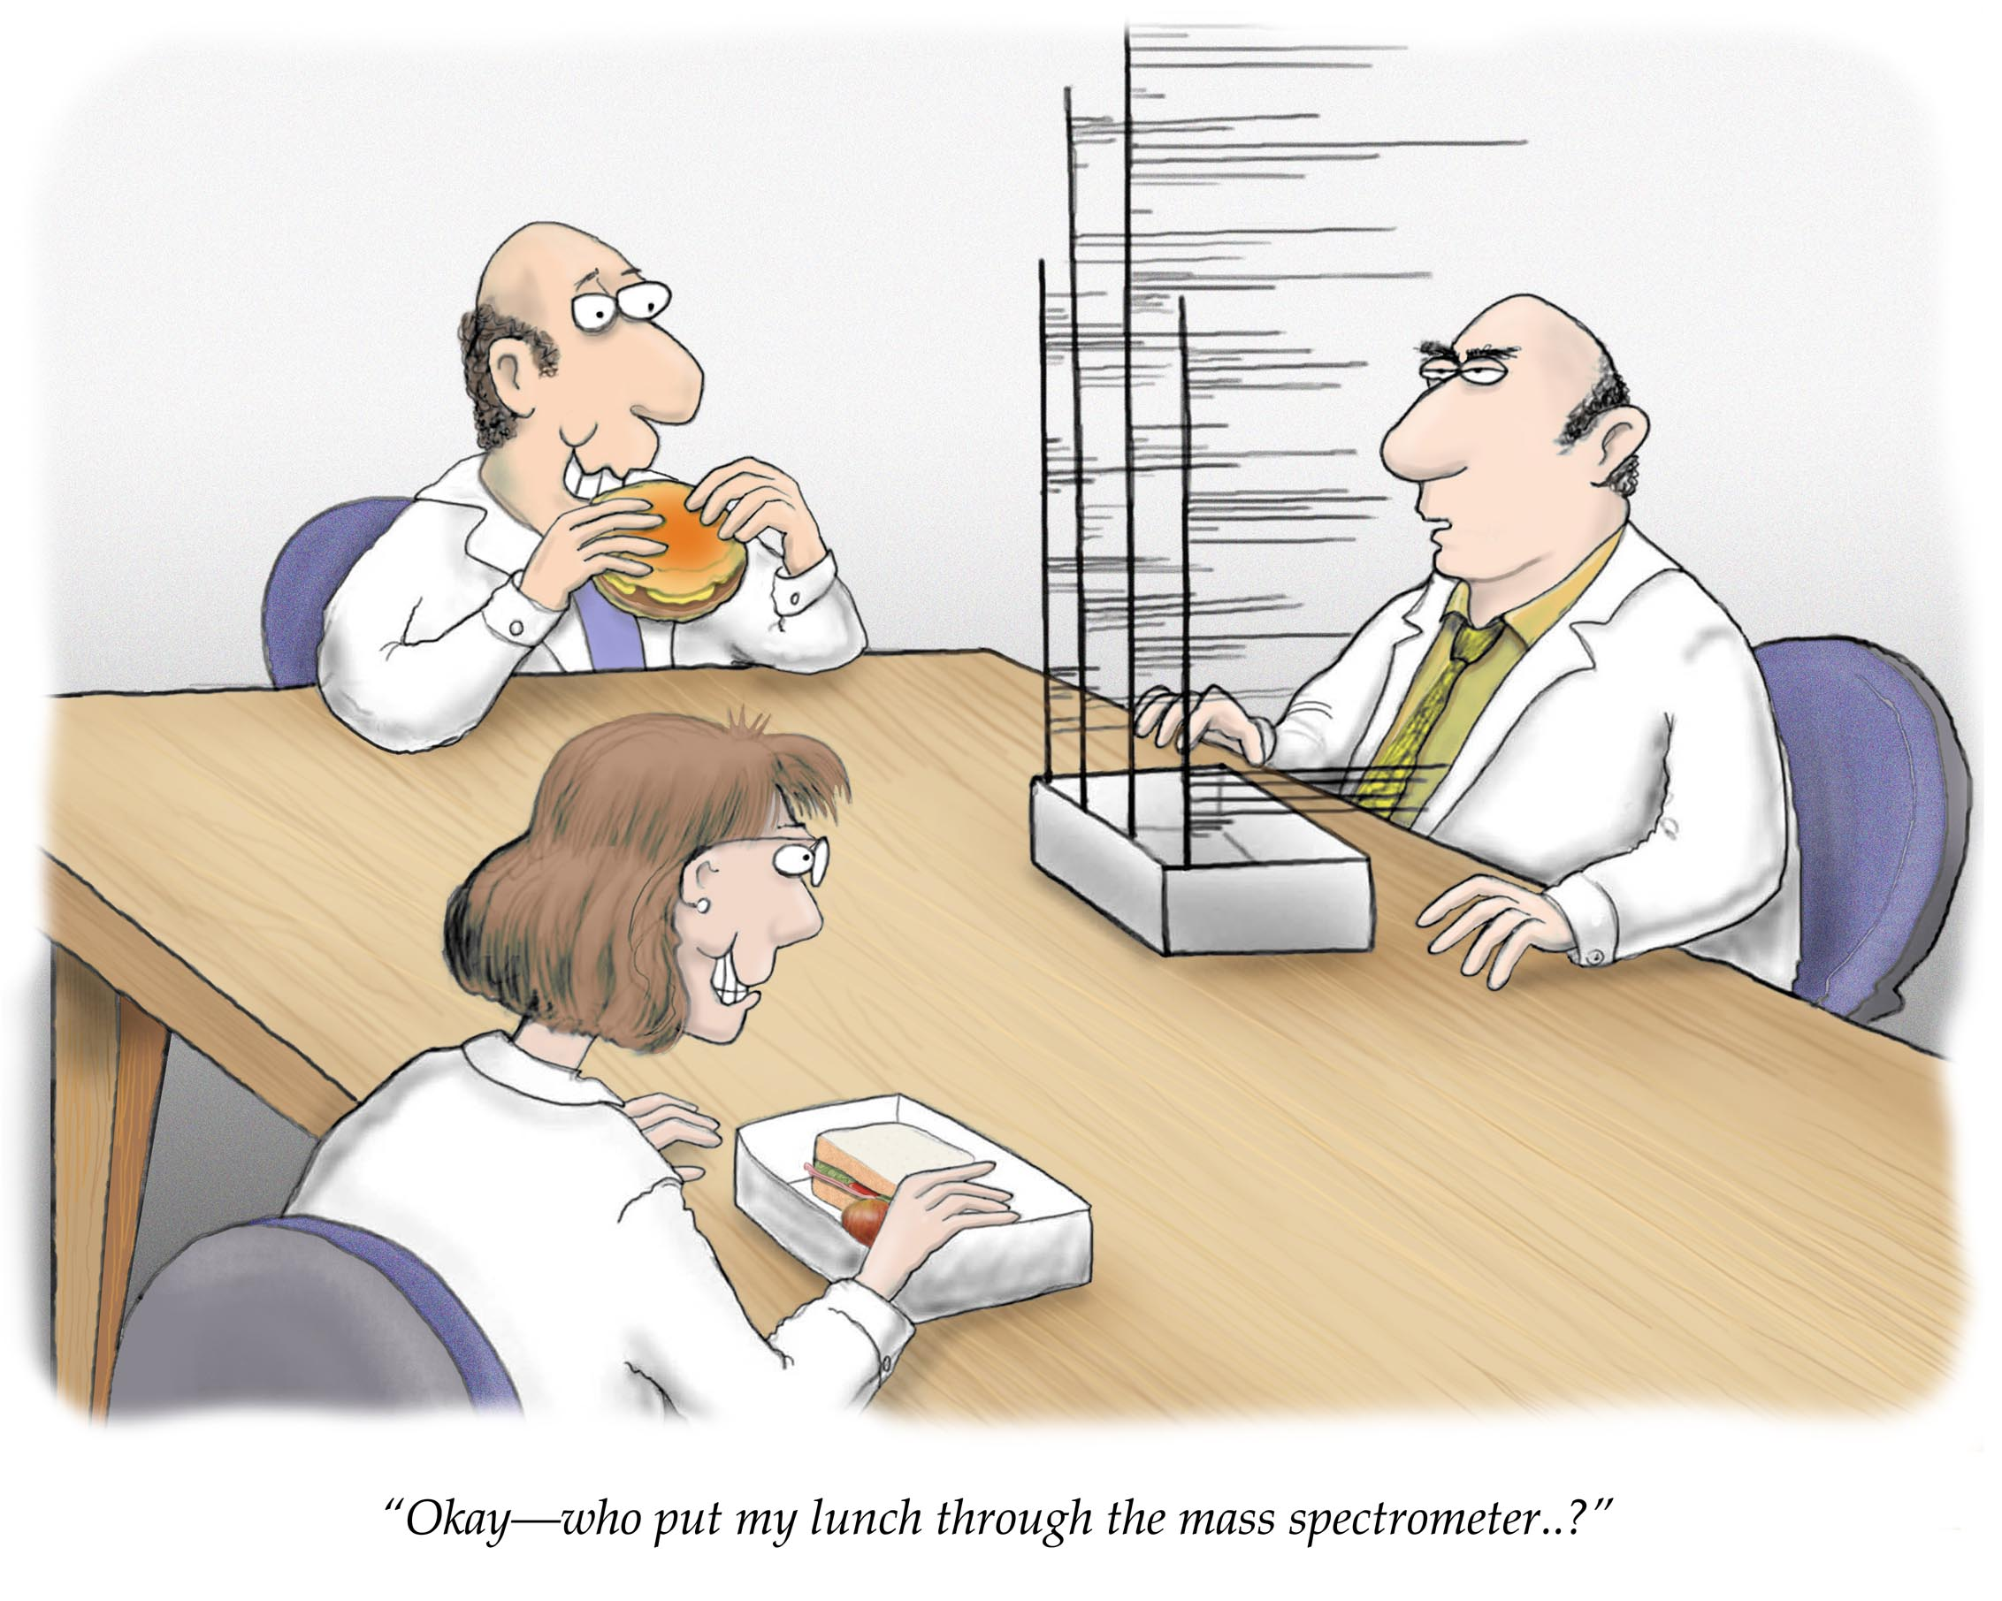
Mass Spectrometry
Courtesy www.lab-initio.com

Slide 2
Purpose of Mass Spectrometry
Produces spectra (graph) of masses from the molecules in a sample of material, and fragments of the molecules.
Used to determine
the elemental composition of a sample
the masses of particles and of molecules
potential chemical structures of molecules by analyzing the fragments
the identity of unknown compounds by determining mass and matching to known spectra
the isotopic composition of elements in a molecule

Slide 3
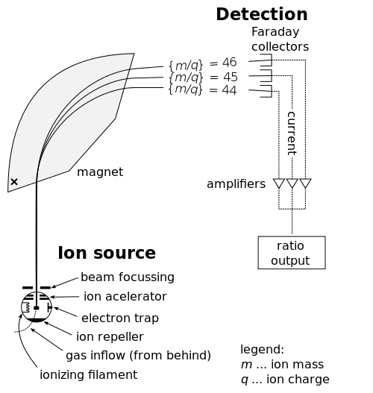
Stages
The ionizer converts some of the sample into ions.
Mass analyzers separate the ions according to their mass-to-charge ratio.
The detector records either the charge induced or the current produced when an ion passes by or hits a surface

Slide 4
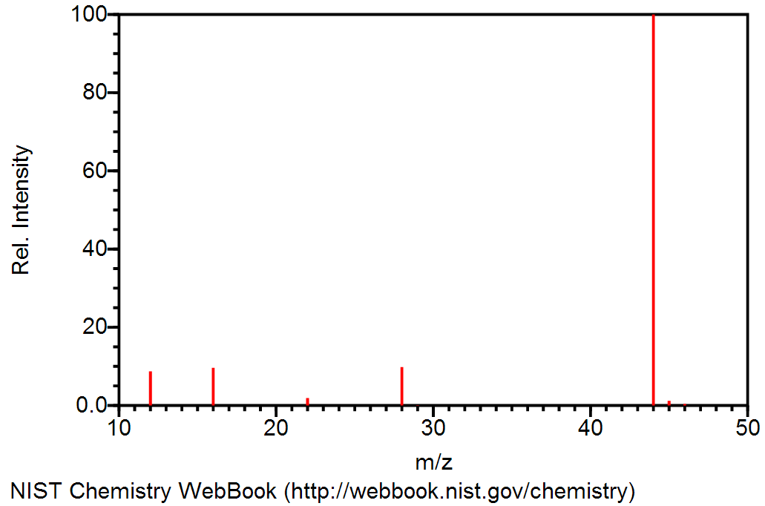
Mass Spectrum of CO₂
Molecular ion peak
[CO₂]⁺ = 44
Fragment Peaks
[C]⁺ = 12
[O]⁺ = 16
[CO]⁺ = 28

Slide 5
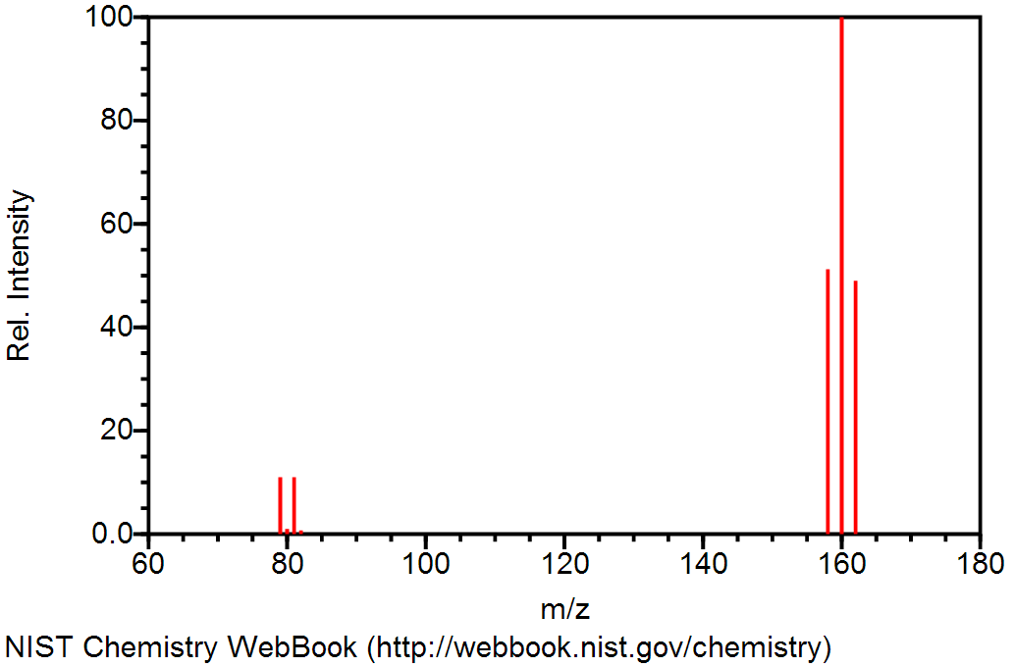
Mass Spectrum of Bromine, Br₂
Bromine has two isotopes: 50.69% ⁷⁹Br and 49.31% ⁸¹Br
Molecular Ion Peaks
[⁷⁹Br⁸¹Br]⁺
[⁷⁹Br⁷⁹Br]⁺
Fragments
[⁸¹Br⁸¹Br]⁺
⁷⁹Br⁺
⁸¹Br⁺

Slide 6
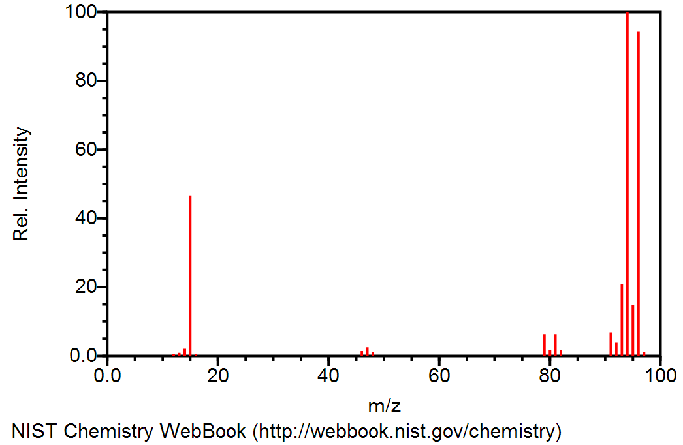
Practice: Methyl Bromide, CH₃Br

Slide 7
Answers: Methyl Bromide, CH₃Br
[CH₃⁸¹Br]⁺
[CH⁸¹Br]⁺ and [CH₃⁷⁹Br]⁺
[CH₂⁸¹Br]⁺
[CH₃]⁺
[C⁸¹Br]⁺ and [CH₂⁷⁹Br]⁺
[CH⁷⁹Br]⁺
[⁸¹Br]⁺
[C⁷⁹Br]⁺
[⁷⁹Br]⁺

Slide 8
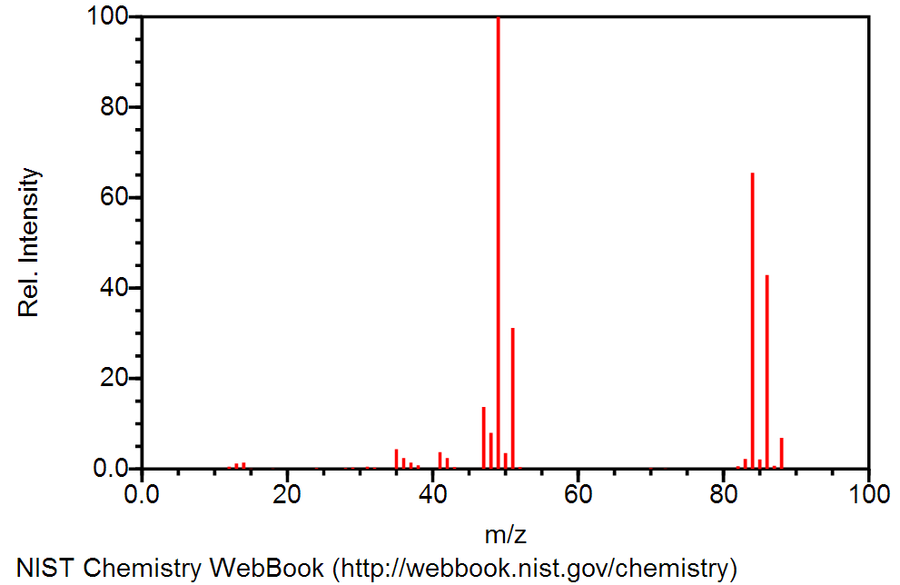
Practice: Methylene Chloride (CH₂Cl₂)
Chlorine is 75.77% ³⁵Cl and 24.23% ³⁷Cl

Slide 9
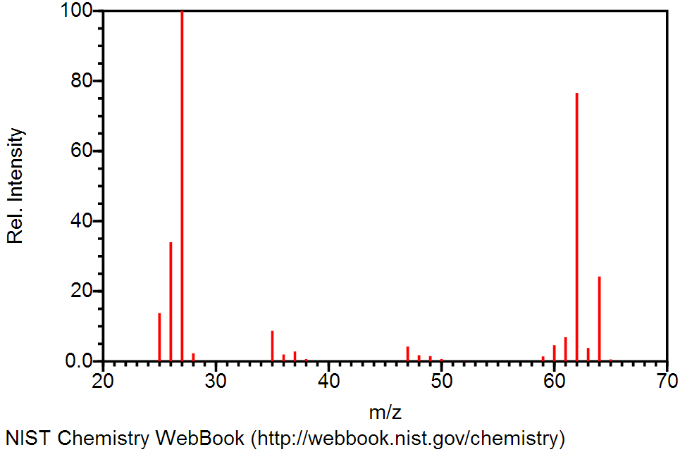
Practice: Vinyl Chloride (CH₂CHCl)
Chlorine is 75.77% ³⁵Cl and 24.23% ³⁷Cl

Slide 10
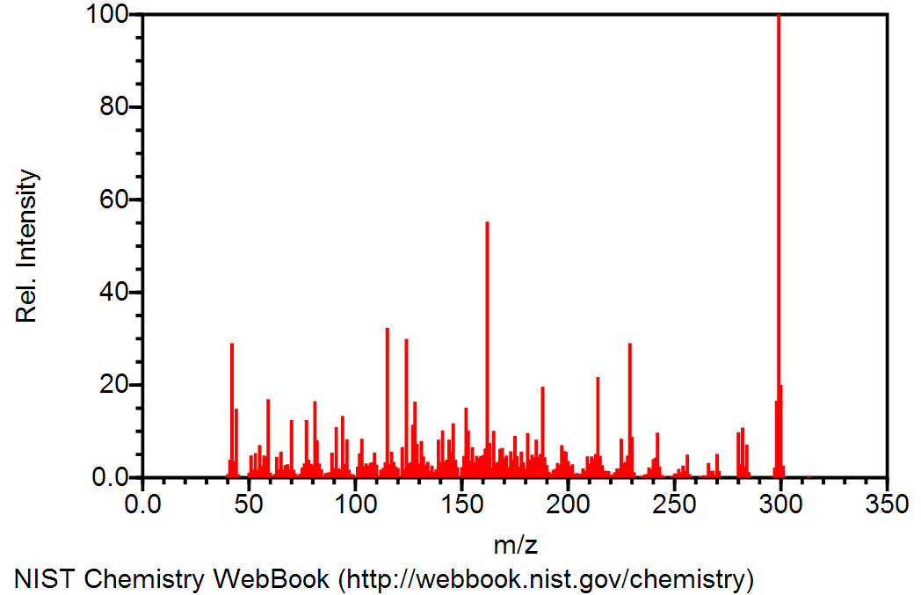
Spectra of Larger Molecules
Spectra of large molecules have many fragments, and the interpretation of their spectra is beyond the scope of this course.
Codeine, C₁₈H₂₁NO₃

Slide 11
Mass Spectrometry in Forensics
Mass spectrometry is used to confirm the identify of unknowns, such as illegal drugs
Unknowns are often not pure, and must be separated from a mixture
Gas chromatography is used to separate the components of the mixture
Mass spectrometry “fingerprints” the components, so that they can be matched to existing known spectra
Gas
Chromatograph
Mass
Spectrometer
Mixture

