Slide 1
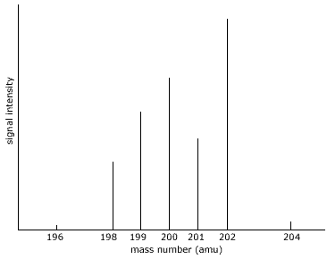
Mass Spectrometry

Slide 2
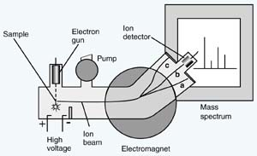
Mass spectrometry
technique for measuring the masses and relative abundances of components in a mixture
produces a mass spectrum
Y-axis: Relative Abundance
X-axis: Mass/Charge ratio

Slide 3
Uses:
find masses of isotopes in a sample
determine structural components of molecules

Slide 4
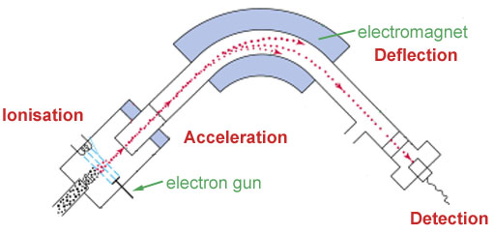
A magnetic field is used to deflect the ions.
A beam of electrons is used to ionize the atoms in the sample
Negatively-charged plates attract the ions.
sample
The ion is detected electrically when it reaches the end of the tube.

Slide 5
Ionization
electrons are knocked off of sample
1+ ions are generated
small proportion of 2+
Acceleration
negatively-charged plates attract the ionized particles

Slide 6
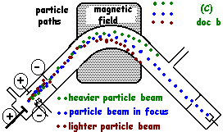
Deflection
an applied magnetic field deflects (changes the path of) the charged particles
degree of deflection - two factors:
mass of particle: Lighter particles are deflected more
charge of particle (don’t need to consider since most are 1+)

Slide 7
Detection
ion hits detection plate → generates a current
current is translated into an electrical signal
intensity of signal indicates relative abundance in the original sample
more intense = more abundant
most abundant
Notes:
alter which ions reach the detector by varying the applied magnetic field

Slide 8
example: sample of Cl₂
Qualitative Interpretation
two distinct isotopes: Cl-35 and Cl-37
Cl-35 is more abundant

Slide 9
Quantitative Interpretation
higher peak is assigned a relative abundance of 100
translate to percent abundances:
Cl-35:
100
% abundance Cl-35:
100
(100+35)
x 100%
= 74%
Cl-37:
35
% abundance Cl-37:
35
(100+35)
x 100%
= 26%
Now calculate weighted atomic mass of Chlorine!

Slide 10
Cl-35:
100
Cl-37:
35
Alternative - Calculating relative atomic mass in one step:
(100 x 35) + (35 x 37)
(100 + 35)
= 35.52

Slide 11
Good Animation
https://www.youtube.com/watch?v=tOGM2gOHKPc

