Slide 1
Henry’s Law
AP

Slide 2
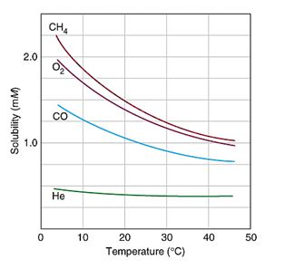
Solubility of Gases in Liquids
Two factors:
Temperature
increase temp, decrease solubility
Pressure
increase pressure, increase solubility

Slide 3
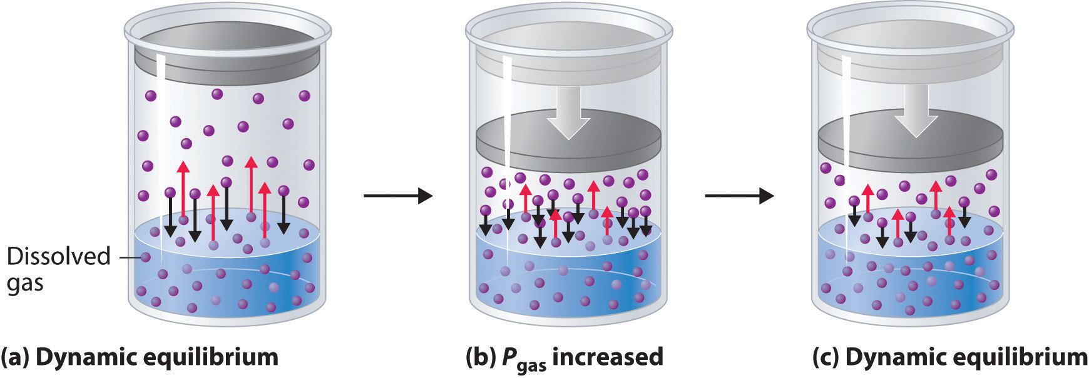
Henry’s Law
The amount of gas dissolved in a solution is directly proportional to the pressure of the gas above the solution.
C_{gas} ∝ P_{gas}

Slide 4
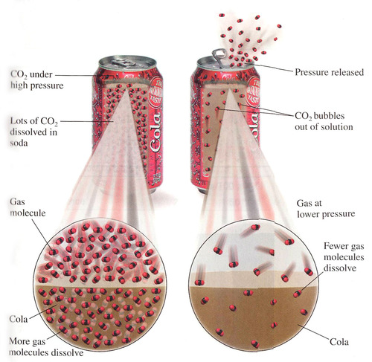

Slide 5
Henry’s Law: Formula
C = k P
concentration of dissolved gas (mol/L)
partial pressure of the gaseous solute, above the solution
(atm, kPa, etc.)
Henry’s Law proportionality constant
specific to solute, solvent, and temperature
Can you deduce the units of the proportionality constant, k?

Slide 6
C = k P
Example
A soft drink is bottled so that a bottle at 25°C contains CO₂ gas at a pressure of 5.0 atm over the liquid. Calculate the equilibrium concentration of CO₂ in the bottled soda. The Henry’s Law constant for CO₂ in aqueous solution is 3.1 x 10⁻² mol/L•atm at 25°C.
1.6 x 10⁻¹ mol/L

Slide 7
Case Study: Decompression Sickness
deep-sea divers experience extremely large pressures
high concentrations of N₂ dissolve in the bloodstream

Slide 8
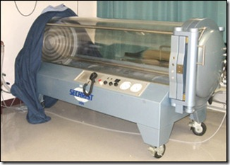
if rising to surface too quickly…
pressure drops
N₂ solubility drops
N₂ forms bubbles in bloodstream
bubbles can interfere with blood flow
Divers must decompress slowly.
Hyperbaric chambers can be used to treat decompression sickness.

