Slide 1
UNIT A
Tissues, Organs and Systems of Living Things

Slide 2


Chapter 1
“Cells are the basic unit of life and often combine with other cells to form tissues.”

Slide 3
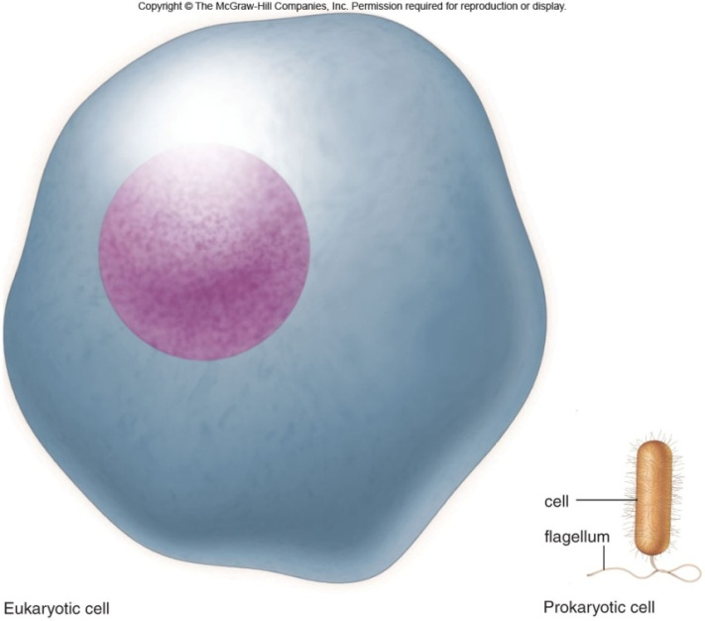
Characteristics of Living Things
Living things have a lifespan.
      Life cycle: birth → grow old → death
Living things grow in size, reproduce and can repair themselves.
      Plants/animals increase in size
      Living things produce offspring
      When hurt living things repair wounds and injuries.
Living things require energy.
      Plants get energy from the Sun
      Humans get energy from food.
Living things produce waste.
      Unusable materials are released to
      the environment as waste, example:
      going to the bathroom.

Slide 4
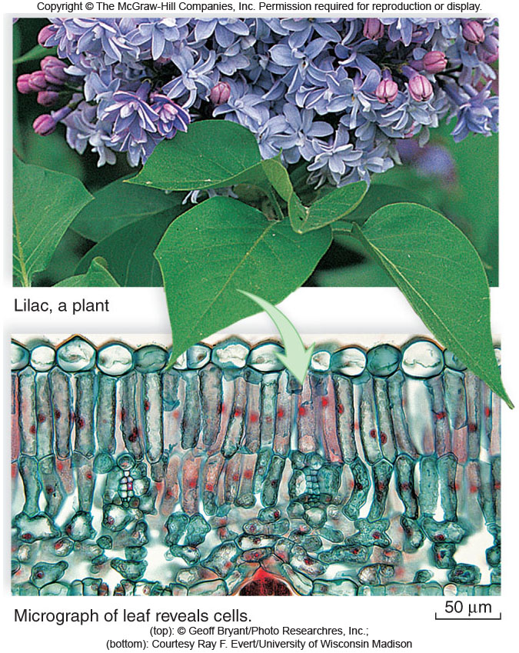
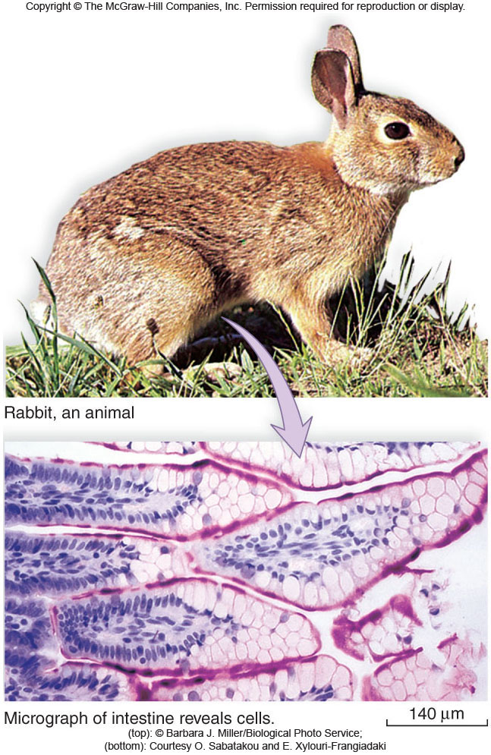
All Organisms are
Composed of Cells

Slide 5
Cells and Cell Theory
“All living things are made of cells.”
Question: What is a cell?
A cell is the smallest and most basic unit of life.
Large organisms, humans, are made of trillions of cells. (10¹³ and 10¹⁴cells)
Other organisms, bacteria, are so small they are only made up of one cell.

Slide 6

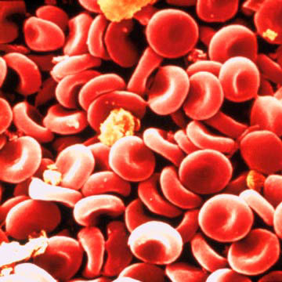
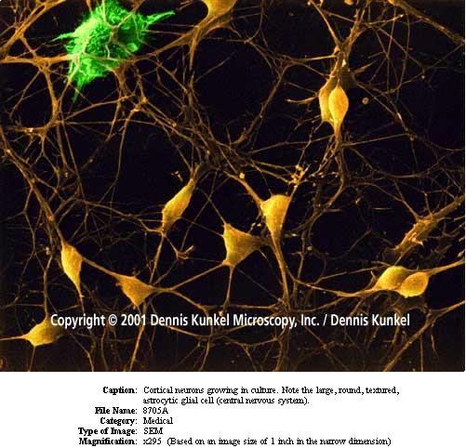
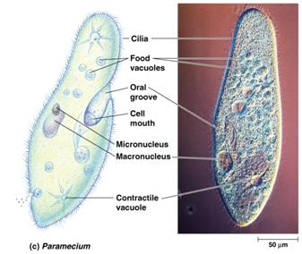
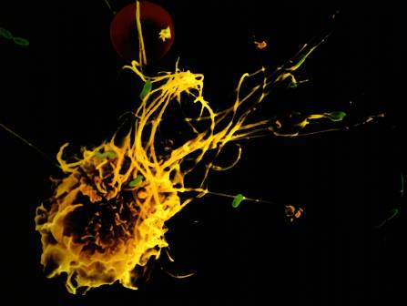
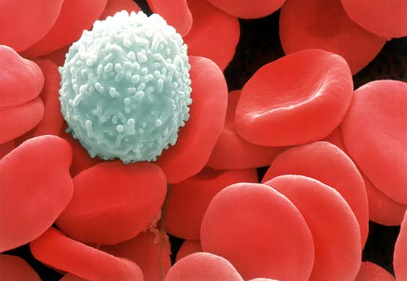
Cells?
Cells weren’t discovered until the 1600’s.
Question: Do you have any idea why?

Slide 7
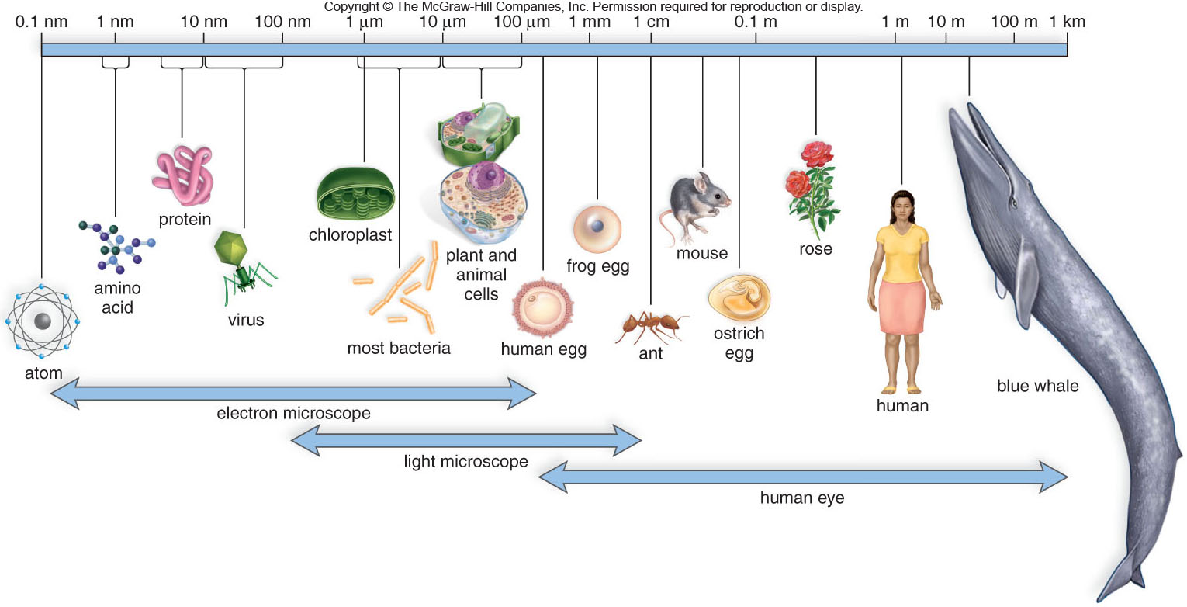
The Sizes of Living Things and
Their Components

Slide 8
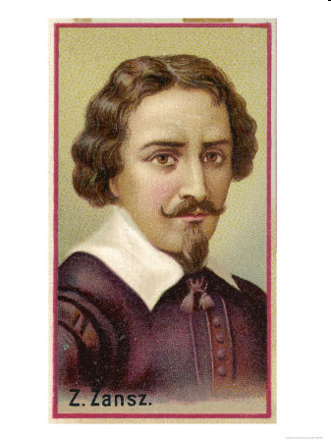
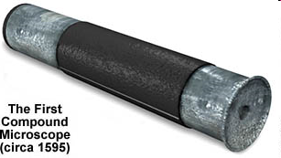
What made the discovery of cells possible???
The invention of the microscope!
Janssen (1590) made the first compound microscope

Slide 9
“All living things are made of cells.”
Cell Theory
Cell Theory states:
  A cell is the basic unit of life.
  All living things are made up of cells.
  All cells come from preexisting cells.

Slide 10
Animal Cell Structure
Each part of your body has a specific function.
ex. Heart = pumps blood
Teeth =chew and break down food.
Organelle – a structure within the cell that has a specific function to help the cell work.

Slide 11
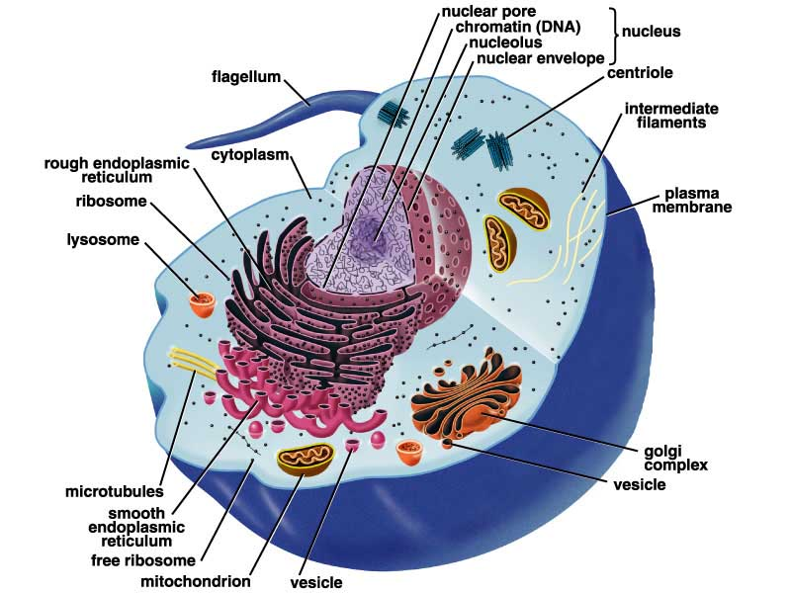
Animal Cell Anatomy

Slide 12
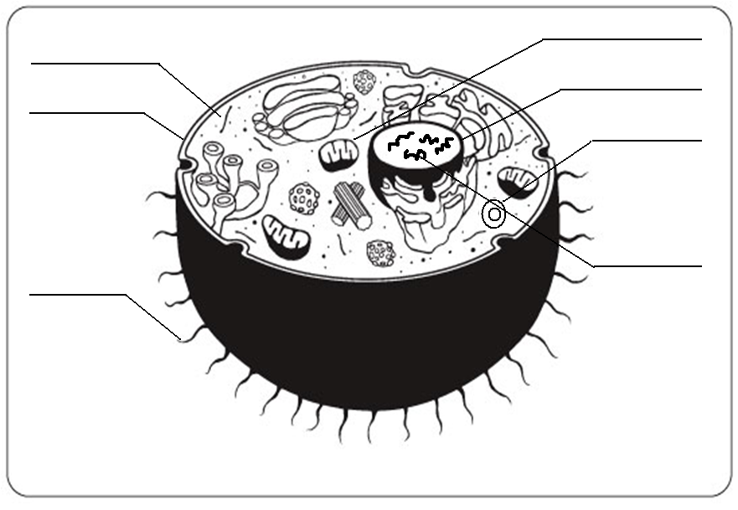
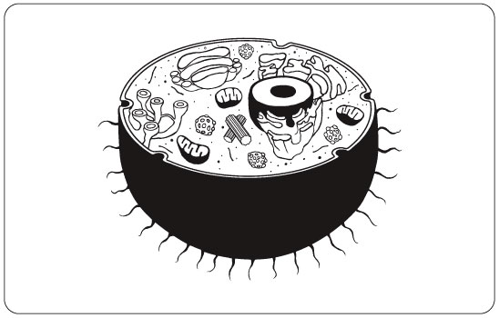
mitocondria
Cytoplasm
nucleus
Cell membrane
Vacuole
DNA
flagella

Slide 13
Cell Membrane
Cell membrane
Function:
Regulates materials entering and exiting the cell.

Slide 14
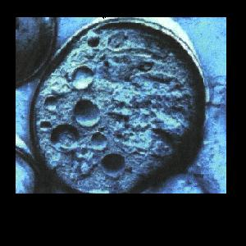
Cytoplasm
Cytoplasm
Function:
All cell organelles are suspended in a jelly-like liquid.

Slide 15
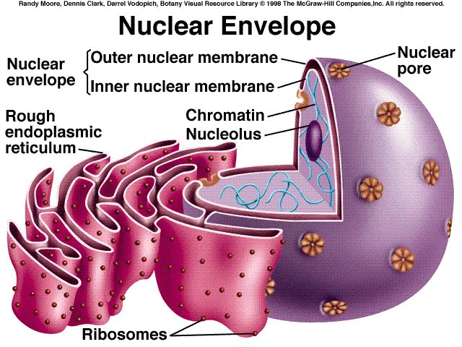
Nucleus
Nucleus
Function:
“Control Center of the brain” Regulates DNA actions and all the cell’s activities.

Slide 16
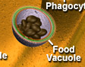
Vacuoles
Vesicles
Function: Storage for water, nutrients or waste.

Slide 17
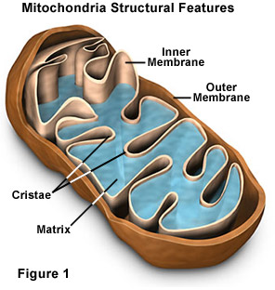
Mitochondria
Mitochondria
Function: Produce energy for the cell – site of cellular respiration converting food and oxygen into a more useful form of energy. “The Powerhouse”

Slide 18
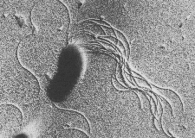
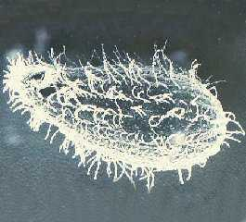
Cilia & Flagella
Flagella
Flagella
Cilia
Function: provides movement for the cell or objects moving by the cell.

Slide 19
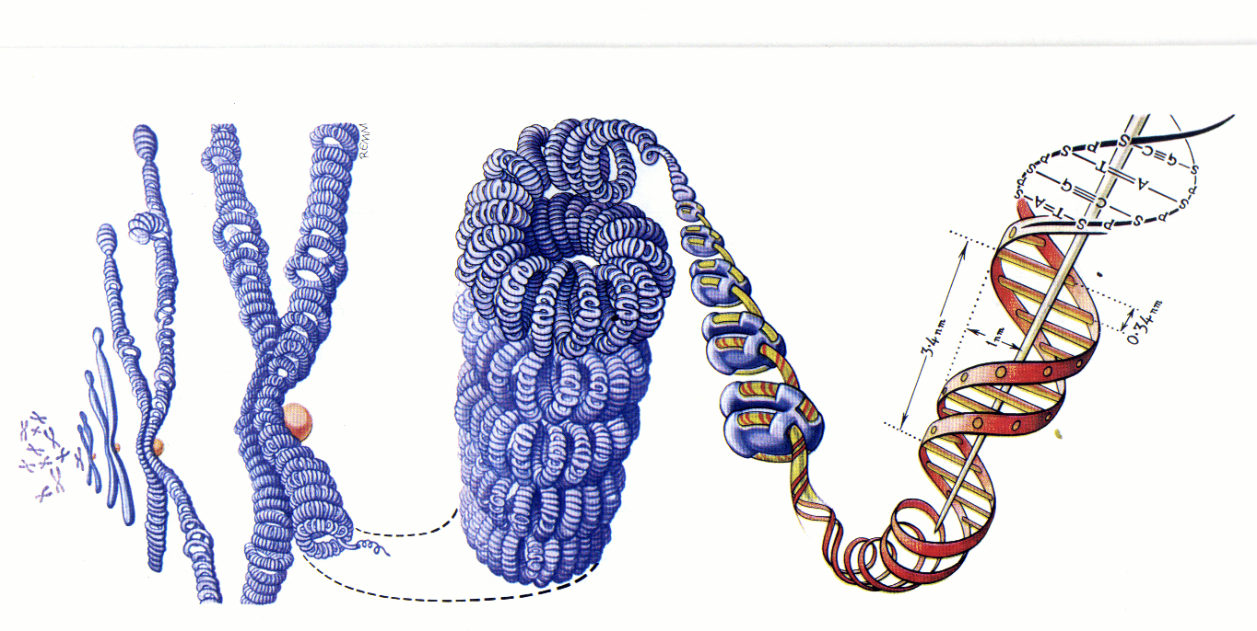
Chromosomes
Chromosomes
Function:
Thread like structures in the nucleus that contain genetic information of the cell.
  – organized DNA (present before cell division

Slide 20
Chromosomes and DNA
DNA (deoxyribonucleic acid):
Is a set of very large molecules that carries genetic information.
Our DNA tells us which species we belong to and tells us what colour eyes, hair etc we will have.
Human contain 46 chromosomes
=23 mother + 23 father
DNA is exactly the same in every cell.
If a change occurs this is called a mutation.

Slide 21
Check and Reflect
☺
Read pages 8-16
Page 25 # 1-3, 5, 9

